Slide 1
Home assistant Dashboard Basic Configuration

Slide 2
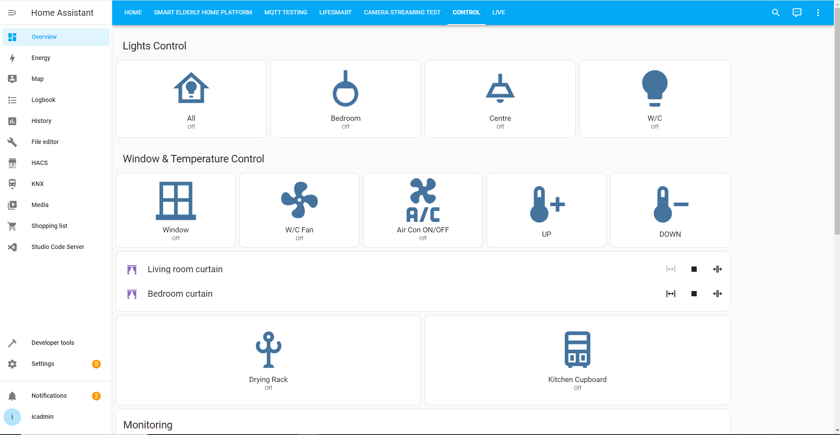
Home Page
Tap Menu
Edit Dashboard
Dashboard
Program Editing
VS Code
YAML Check
Device & Automation & Integrations

Slide 3
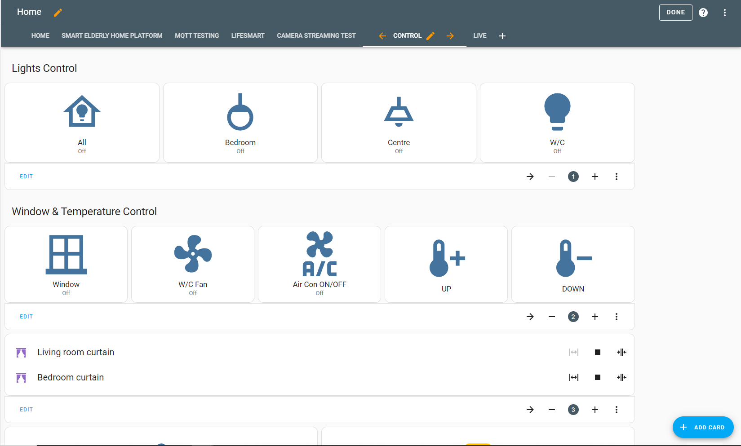
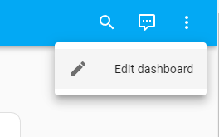
Edit Dashboard
Done Editing
Step 1
Step 2
Add new item/Control

Slide 4
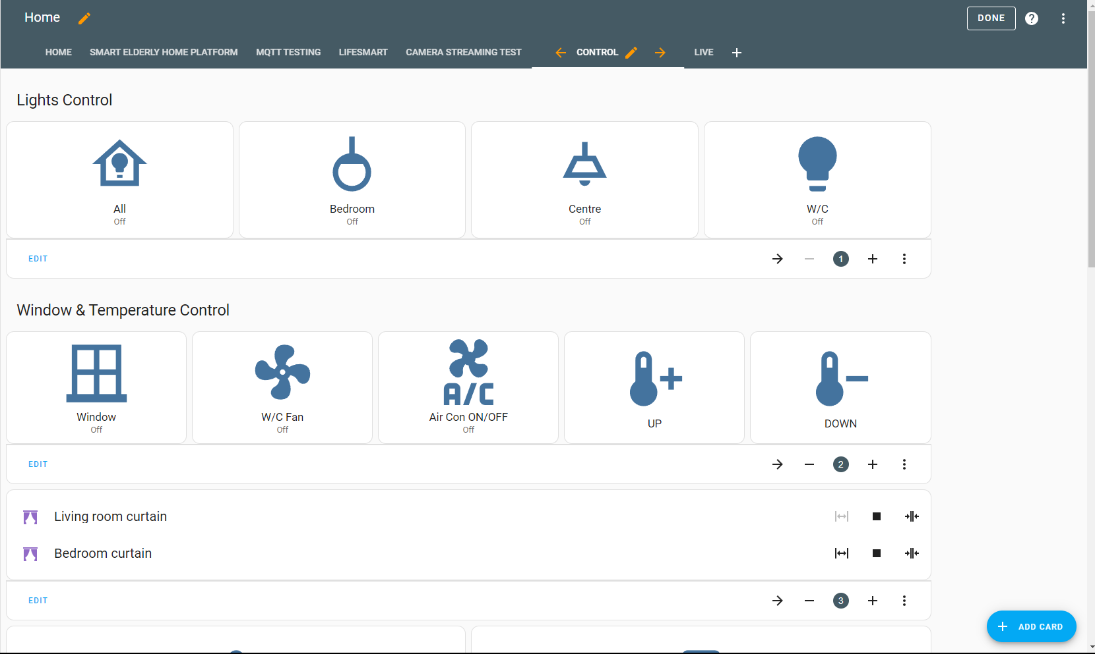
Edit Dashboard
Edit page name
Edit Card Content
Edit Order

Slide 5
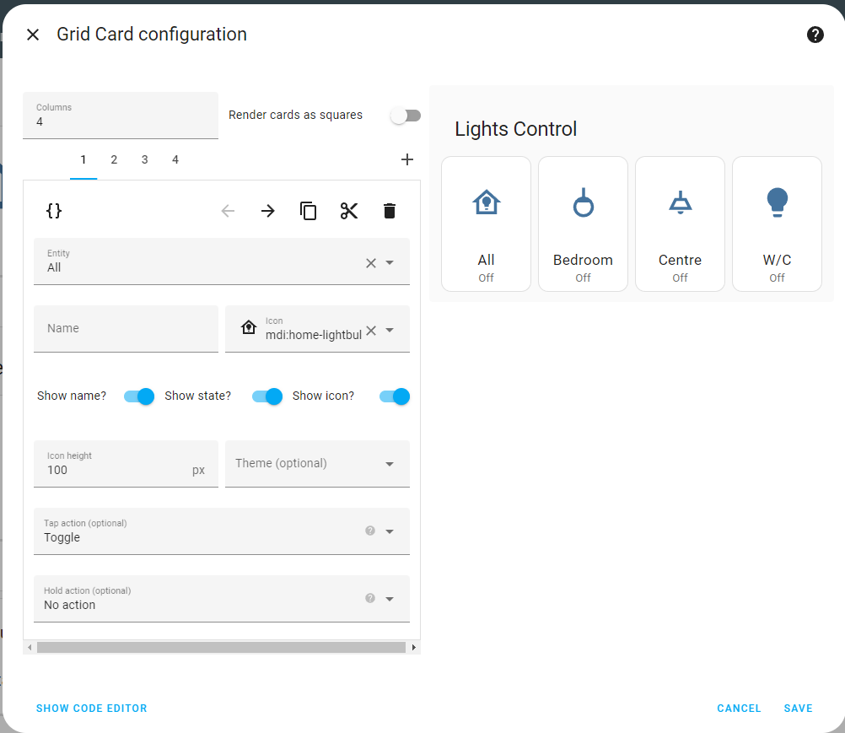
Edit Grid Card
Search entity name
Display Name
Display order
Display Name
Code format
Ref: https://www.home-assistant.io/dashboards/grid/

Slide 6
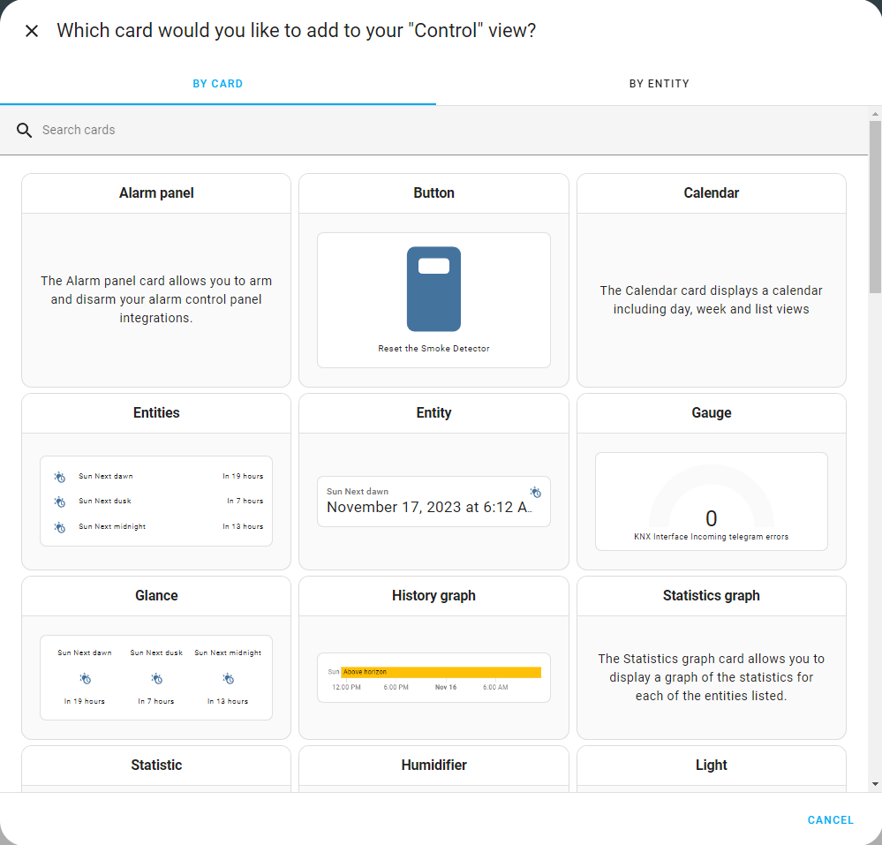
Add a new card
Card Type
Button (switch)
Entities / Entity (Sensor)
Glance (Sensor)
Light (Light control)
Map (Location)
Picture (Image/Video)
Grid (Multi-device)
Horizontal / Vertical Stack (Multi)

Slide 7
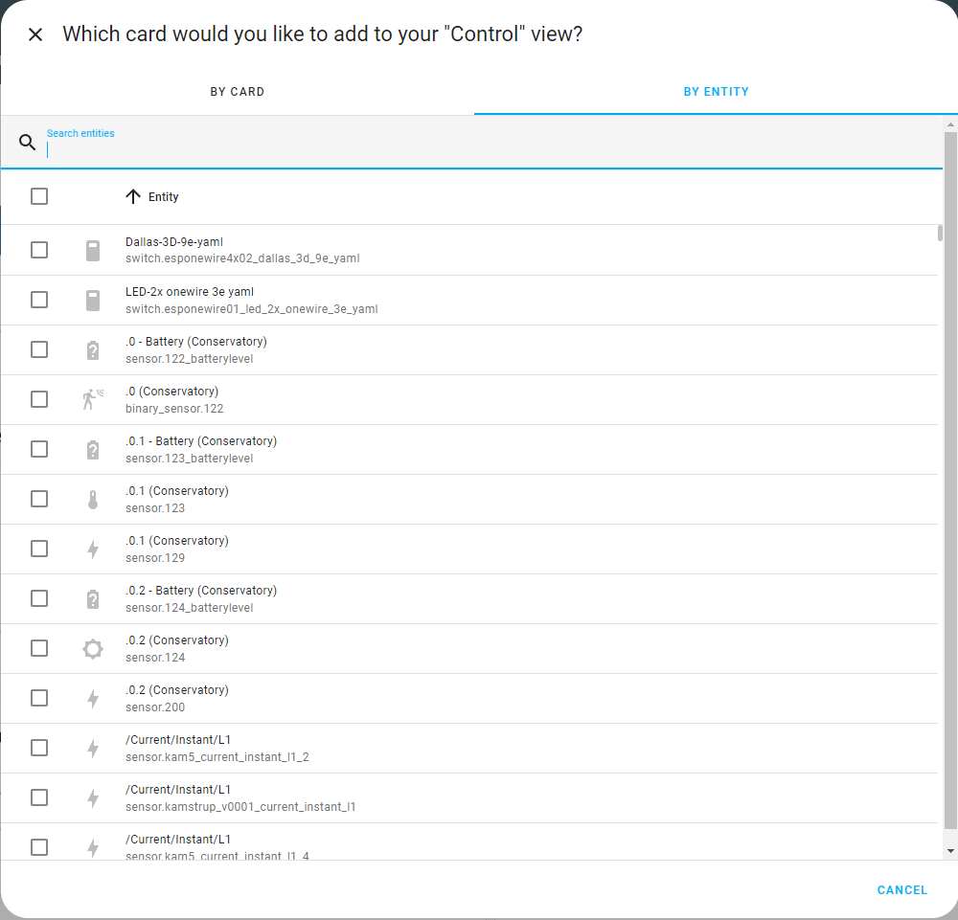
Add a new entity
Search with entities name
Search with the entity name
Entity can be added in configuration.yaml
Device Class
Binary Sensor
Button
Cover
Humidifier
Media Player
Number
Sensor
Switch
Entities for connected devices
https://www.home-assistant.io/docs/configuration/customizing-devices/

Slide 8
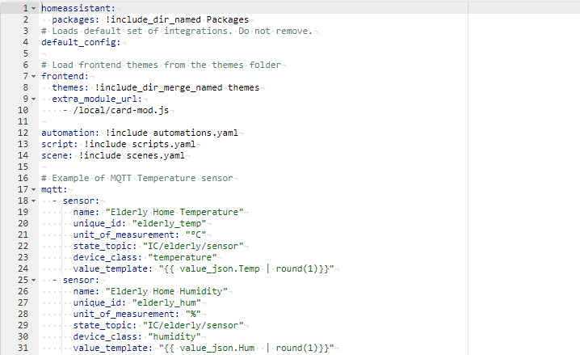
Configuration.yaml
Integration Name
MQTT Topic
Extract data from json
{{ value_json.<Key>}}
Entities Type
https://www.home-assistant.io/docs/configuration/customizing-devices/

